Slide 1
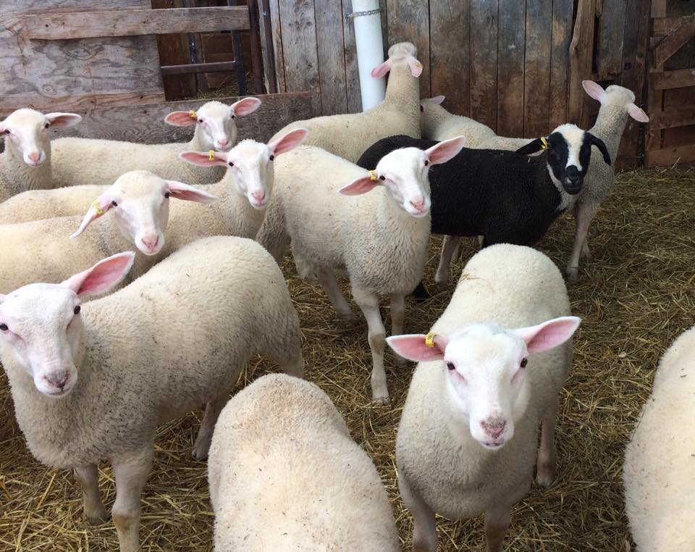
How to add information to your listing in the DSANA Member Directory

Slide 2
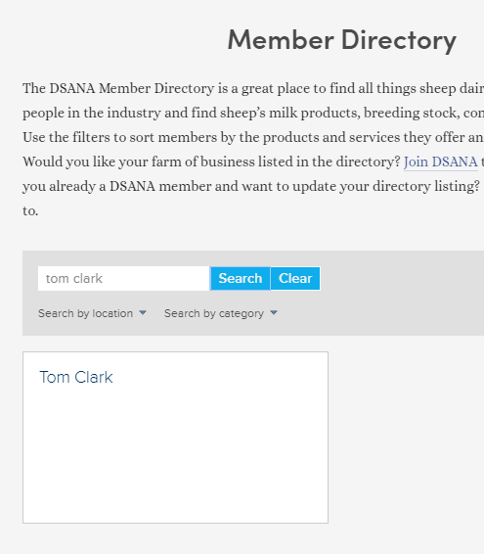
DSANA members automatically have a listing in the Member Directory
Put your name, or your farm’s name in the search bar. Your listing will show a blank card until you add the information, graphics, or photographs that you want others to see.

Slide 3
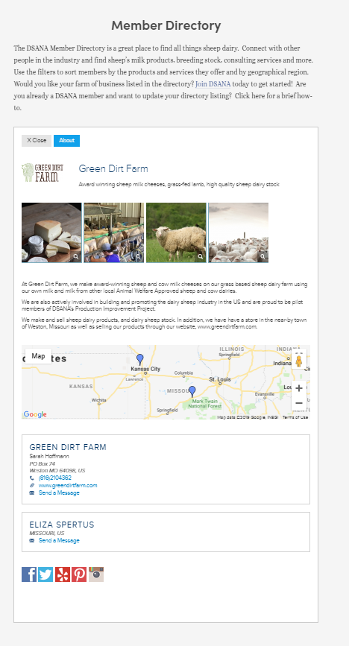
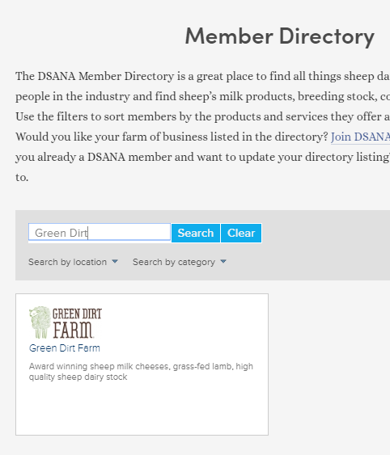
DSANA members automatically have a listing in the Member Directory
And this:
The next series of slides will show you how to go from this:
To this:
In 4 easy steps!

Slide 4
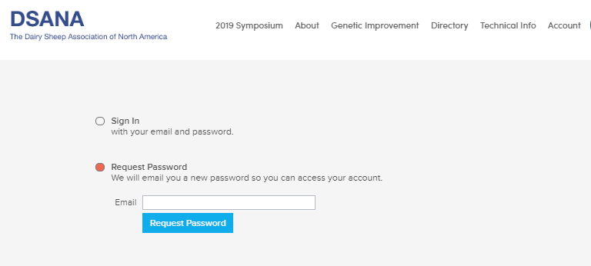
1. Log in to your account
Click on “Account” at the top right of the screen.
If you are logging in to the new DSANA website for the first time, you may need to set a new password.

Slide 5
2. Once you’re logged in, you can start by changing any basic information underneath the “About” button
Here you will see, and make any changes to, your farm or business’s primary information, including the primary contact under your Bundle Membership (remember you can have up to five farm or business members included in your DSANA membership), email address, website, etc.
Don’t forget to save!!

Slide 6
3. Add the information, graphics, and pictures you would like shown in your Member Directory profile
Click on the “Profile” button
Here, you are going to add fill out your “business card”, add pictures to your gallery, add any social media links you have, and click the searchable product/service categories.
The next four slides will walk you through the extremely easy process.

Slide 7
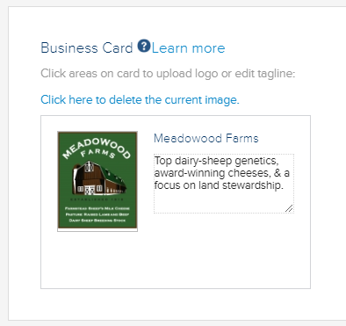
3a. Directory profile – first the “business card” that contains your logo, and a very brief description of your products or offerings
Add a logo and a brief product list to the business card that first appears in the Member Directory
You are limited to 80 characters on this product list.
You can upload any graphic from your own files, and then will enter the short list of products or services you offer.
Here, we highly recommend that you watch the short video on the product list.

Slide 8
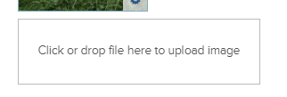
3b. Directory Profile – Add pictures to your gallery
Next, upload your own pictures that your would like to show in your gallery.
It’s really easy: just click on the box and select the picture you want from your own files.

Slide 9
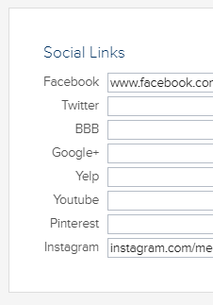
3c. Describe your farm or business, and add any social media accounts.
These social media accounts will show up as icons at the bottom of your Profile in the Member Directory.
And then add the URLs for any social media accounts.
This is where you can say all you want about your farm, business, products, services.
This description will be shown underneath the photo gallery in your Profile in the Member Directory.

Slide 10
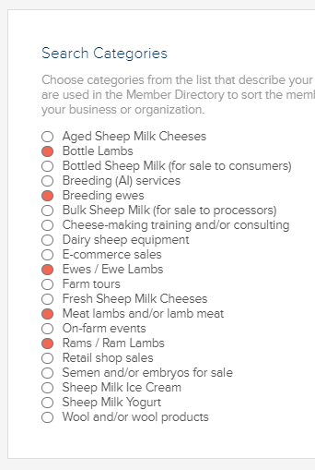
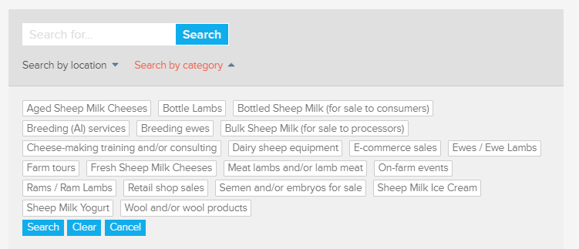
3d. Click the products or services you have to offer.
¶ This is what allows the public to search for the products you have to offer. You can click as many or as few as you wish.
For example, if you have clicked “Fresh sheep milk cheeses” in the search category, and someone searches for “Fresh sheep milk cheeses” (above), your farm will come up in the filtered listing in the Member Directory.

Slide 11
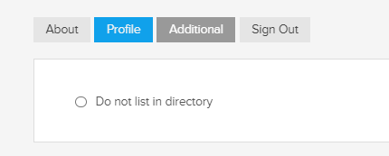
3e. Don’t forget to save!!
p.s. You can opt out of having a public listing in the Member Directory

Slide 12
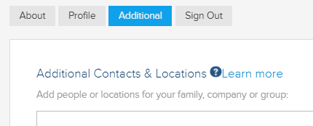
4. Add information about the additional farm or business members who are part of your DSANA membership
Here you can add the names and contact information for other members who are included in your Bundle Membership (remember you can have up to five farm or business members included in your DSANA membership), email address, website, etc.
These additional contacts, with their own individual contact information, will appear as part of your Member Directory listing.
There is an easy ** 44-second** video that helps you with this section.

Slide 13
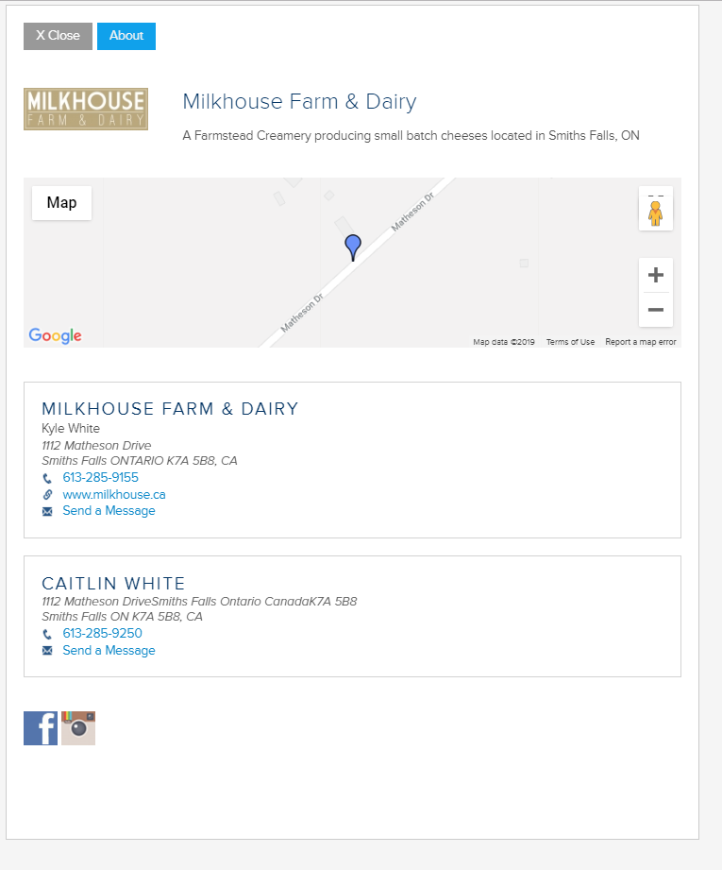
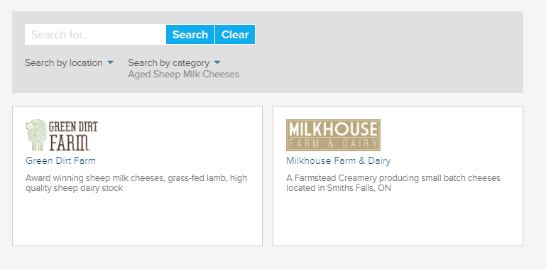
5. Check out your new searchable listing!
And then, when we clicked on the business card of Milkhouse Farm & Dairy, we are shown their full profile:
As an example, we searched on “Aged Sheep Milk Cheeses”, and the Member Directory shows the “business cards” of farms that had clicked on that product category.

