Slide 1
Using the numbers: how performance recording contributes to genetic gain and economic opportunities in sheep dairying
Ron Lewis
Department of Animal Science
University of Nebraska-Lincoln
DSANA Annual Conference
Kansas City, Missouri
Friday, Nov. 8, 2018

Slide 2
Today’s talk
Introduction
Parsing out the genetics
A better methodology
  Best Linear Unbiased Prediction
Making genetic change
Setting future priorities

Slide 3
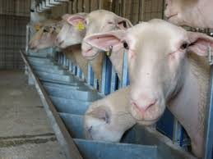
Introduction
Why bother with genetic selection in the first place?
  It is relatively slow, compared to other methods
  But it garners huge benefits by being
    Permanent
    Cumulative
    In most cases, highly cost effective

Slide 4
Improvement in milk yield (French Lacaune)
(Barillet et al., 2001)

Slide 5

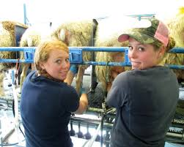
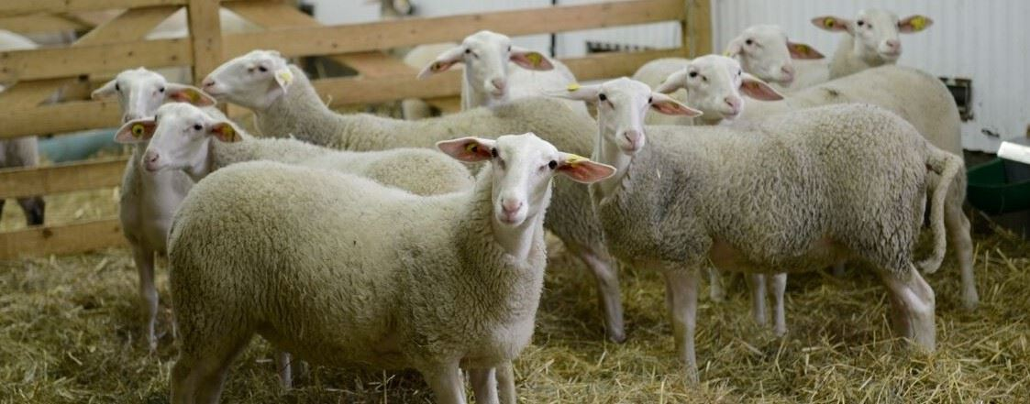
Parsing out the genetics
Qualitative genetic evaluation is about parsing variation
P =
G +
E
Genotype (EPD):
Milk yield (220 day): +86.5 kg
Fat % in milk: -0.09 %
Protein % in milk: +0.00 %
Notes:
Heritabilites are 0.15, 0.28, 0.24 and 0.39 for WWT, PWWT, PFAT and PEMD, respectively, in LAMBPLAN runs for terminal sires.

Slide 6
Breeding value (BV)
Reflects the value of the genes (or alleles) inherited from parents for a trait of interest
  If alleles confer, on average, higher merit, the animal’s breeding value will be higher
  The opposite also holds true

Slide 7
Estimated breeding value (EBV)
Unfortunately, we cannot directly ‘see’ an animal’s breeding value for most economically important traits
  E.g. milk yield, percentage fat in the milk, percentage protein in the milk, somatic cell score, litter size
Therefore we have to estimate it

Slide 8
Heritability (h²)
Heritability is
  The degree to which offspring resemble their parent’s performance for some trait
  Proportion of animals’ performance for a trait that is due to breeding value for that trait
Our estimate of breeding value improves for traits that are more heritable

Slide 9
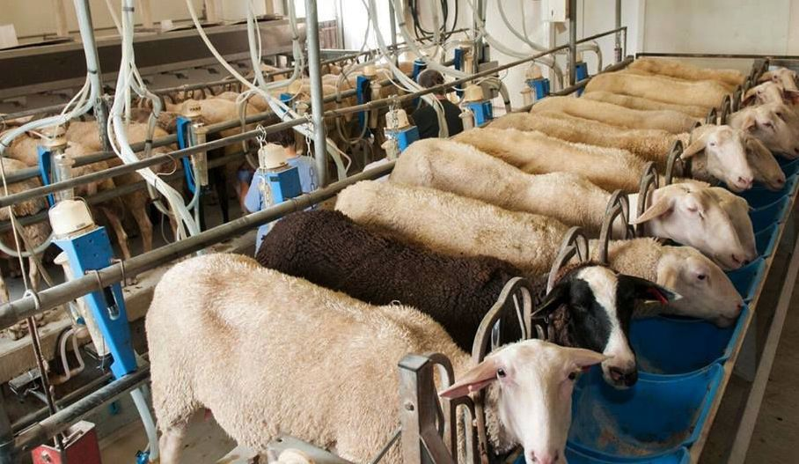
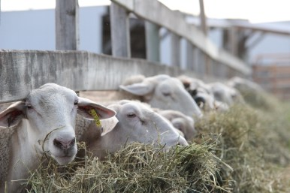
Heritability (h²)
Spooner Agricultural Research Center (Murphy et al., 2017)

Slide 10
Heritability (h²)
Spooner Agricultural Research Center (Murphy et al., 2017)
Trait | Milk yield (MY)‡ | Percent fat (%F) | Percent protein (%P) | Somatic cell score (SCS)
MY | 0.31
%F |  | 0.53
%P |  |  | 0.61
SCS |  |  |  | 0.13
‡ kg in 180 day lactation

Slide 11
Estimating a breeding value
EBV = h² X (animal’s own – flock avg. performance)
Trait | h² | Flock avg.
Milk yield‡ (MY) | 0.31 | 396.0 kg
Percent fat (%F) | 0.53 | 6.30 %
 | Ewe one |  | Ewe two
Trait | Perf. | EBV | Perf. | EBV
MY‡ | 385.2 kg |  | 455.3 kg
%F | 5.94 % |  | 5.26 %
‡ In 180 day lactation

Slide 12
Estimating a breeding value
EBV = h² X (animal’s own – flock avg. performance)
Trait | h² | Flock avg.
Milk yield‡ (MY) | 0.31 | 396.0 kg
Percent fat (%F) | 0.53 | 6.30 %
 | Ewe one |  | Ewe two
Trait | Perf. | EBV | Perf. | EBV
MY‡ | 385.2 kg | (0.31) X (369.2 – 396.0) = - 3.3 kg | 455.3 kg
%F | 5.94 % | (0.53) X (5.94 – 6.30) = - 0.19 % | 5.26 %
‡ In 180 day lactation

Slide 13
Estimating a breeding value
EBV = h² X (animal’s own – flock avg. performance)
Trait | h² | Flock avg.
Milk yield‡ (MY) | 0.31 | 396.0 kg
Percent fat (%F) | 0.53 | 6.30 %
 | Ewe one |  | Ewe two
Trait | Perf. | EBV | Perf. | EBV
MY‡ | 385.2 kg | (0.31) X (385.2 – 396.0) = - 3.3 kg | 455.3 kg | (0.31) X (455.3-396.0) = +18.4 kg
%F | 5.94 % | (0.53) X (5.94 – 6.30) = - 0.19 % | 5.26 % | (0.53) X (5.26 – 6.30) = - 0.55 %
‡ In 180 day lactation

Slide 14
What do these EBV mean?
Milk yield
Ewe one predicted to yield 3.3 kg less milk than an average ewe
Ewe two predicted to yield 18.4 kg more milk than an average ewe
Ewe two predicted to yield 18.4 – (-3.3) = 21.7 kg more milk than ewe one
Percentage fat
Ewe one predicted to produce 0.19% less fat % in milk than an average ewe
Ewe two predicted to produce 0.55% less fat % in milk than an average ewe
Ewe one predicted to produce -0.19 – (-0.55) = 0.36% more fat % in milk than ewe one

Slide 15
Genetic correlation
Higher milk yield tended to coincide with lower percentage fat: why so?
Trait | Milk yield (MY)‡ | Percent fat (%F) | Percent protein (%P) | Somatic cell score (SCS)
MY | 0.31 | -0.31 | -0.34 | 0.30
%F |  | 0.53 | 0.61 | 0.21
%P |  |  | 0.61 | 0.03
SCS |  |  |  | 0.13
‡ kg in 180 day lactation
(Murphy et al., 2017)

Slide 16
Genetic correlation
Occurs when an allele affects more than one trait
  A good example is ‘growth’ genes
Separate from their sign, correlations can be favorable or unfavorable in practice
  Negative genetic correlation of milk yield with percentage fat and protein in the milk
  Positive genetic correlation of milk yield with somatic cell scores

Slide 17
Genetic correlation
When unfavorable, it complicates selection programs
Still, all is not lost
  When small to moderate in sign, still will find animals with favorable breeding values for the pair of traits
  E.g., animals with high breeding values for milk yield and for milk components

Slide 18
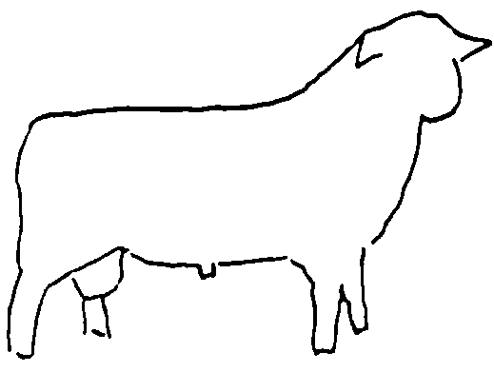
But can we do better?
Sire
Dam
Individual
Full-sib
Half-sibs
Progeny

Slide 19
A better methodology: Best Linear Unbiased Prediction (BLUP)
It is better because it
Uses information from all animals within a breed for the trait of interest, and from correlated traits
Accounts for strength of pedigree (or genomic) relationships
  E.g., learn more from progeny than half-sibs
Accounts for non-random mating

Slide 20
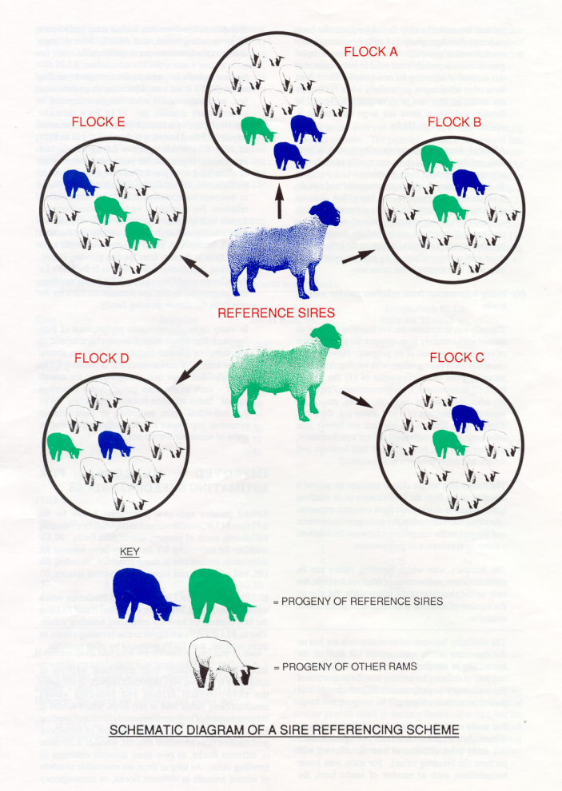

A better methodology: Best Linear Unbiased Prediction (BLUP)
With genetic connections across flocks, it disentangles genetics from the environment

Slide 21
Importation of Lacaune semen
Imported from Genelex in France in 2017 and 2018
Rams shared across-flocks by AI
Notes:
Provided some assistance to Tom Clark

Slide 22
Importation of Lacaune semen
Notes:
Production Index – this index groups three factors together: the milk quantity, fat content and protein content.
Prod. & Function Index – this is overall index that provides a weighting of 50% for the production index (includes milk quantity, fat, and protein) and equivalent weighting of 50% for the functional index (udder morphology and somatic cell count).

Slide 23

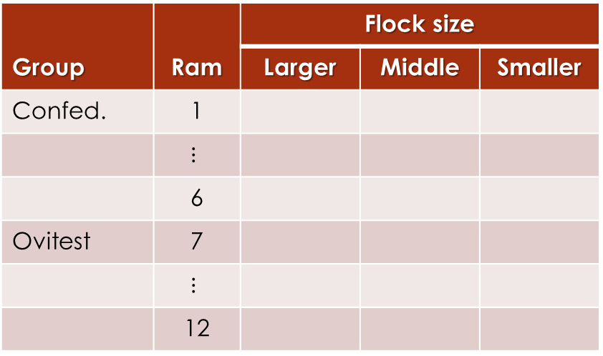
Importation of Lacaune semen
 |  | Flock size
Group | Ram | Larger | Middle | Smaller
Confed. | 1
 | $$⋮$$
 | 6
Ovitest | 7
 | $$⋮$$
 | 12

Slide 24
A better methodology: Best Linear Unbiased Prediction (BLUP)
Simply said, BLUP does a better job of parsing variation
Still, the goal is unchanged: to reliably estimate breeding value

Slide 25
GenOvis
Provides breeding values obtained using BLUP
Report an Expected Progeny Difference (EPD) rather than an Estimated Breeding Value (EBV)
EPD = (1/2) X EBV

Slide 26
GenOvis
Performance at first parity
 | Ewe A |  |  |  | Ewe B
Trait | EPD | Acc. | % |  | EPD | Acc. | %
MY‡ | +15.83 |  |  |  | +86.49
%F | +0.04 |  |  |  | -0.09
%P | +0.11 |  |  |  | +0.00
SCS | -0.24 |  |  |  | +0.37
‡ In 220 day lactation

Slide 27
Accuracy
A higher accuracy indicates that the estimate more closely aligns with the ‘true’ breeding value
Affected by
  Heritability
  Number of performance records
  Closeness of relatives providing the information

Slide 28
GenOvis
Performance at first parity
 | Ewe A |  |  |  | Ewe B
Trait | EPD | Acc.§ | % |  | EPD | Acc.§ | %
MY‡ | +15.83 | 78 |  |  | +86.49 | 74
%F | +0.04 | 50 |  |  | -0.09 | 71
%P | +0.11 | 50 |  |  | +0.00 | 71
SCS | -0.24 | 50 |  |  | +0.37 | 71
§ Accuracy
‡ In 220 day lactation

Slide 29
Percentile ranking
A ranking of animals within breed
Values range from 1 to 99 expressed as %
Animals with higher rankings (closer to 99%) have better potential to produce higher merit progeny

Slide 30
GenOvis
Performance at first parity
 | Ewe A |  |  |  | Ewe B
Trait | EPD | Acc.§ | % |  | EPD | Acc.§ | %
MY‡ | +15.83 | 78 | 80 |  | +86.49 | 74 | 99
%F | +0.04 | 50 | 79 |  | -0.09 | 71 | 39
%P | +0.11 | 50 | 88 |  | +0.00 | 71 | 56
SCS | -0.24 | 50 | 12 |  | +0.37 | 71 | 94
§ Accuracy
‡ In 220 day lactation

Slide 31
Making genetic change
Simulated a dairy sheep operation
Selected for milk yield alone
Assumed a generation interval of 3.5 years
Used $2.2/kg milk (current average value for fluid sheep milk in U.S.; Catherine Durham, personal communications)
(Murphy et al., 2018; Barillet and Boichard, 1987)

Slide 32
Making genetic change
Considered three scenarios
Keep top 30%

Slide 33
Making genetic change
Considered three scenarios
Keep top 50%

Slide 34
Making genetic change
Considered three scenarios
Keep top 70%

Slide 35
Making genetic change

Slide 36
Setting future priorities
In the U.S. and internationally milk yield represents more than 2/3 total income to sheep dairies
Premiums or discounts on component traits currently uncommon
Likely should first focus on genetic gain in milk yield until reach target values

Slide 37
Setting future priorities
However with most sheep milk processed into cheese, higher fat and protein percentages, and lower somatic cell scores, affect cheese yield and taste
Unfavorable genetic correlations between milk yield and other traits complicates selection decisions

Slide 38
Setting future priorities
“... improving milk yield is the priority. However, positive selection should also be put on percentage fat and protein in order to produce good milk for cheese production. Positive pressure should be maintained on litter size.”
Professor Dave Thomas (Emeritus)
Univ. Wisconsin-Madison

Slide 39
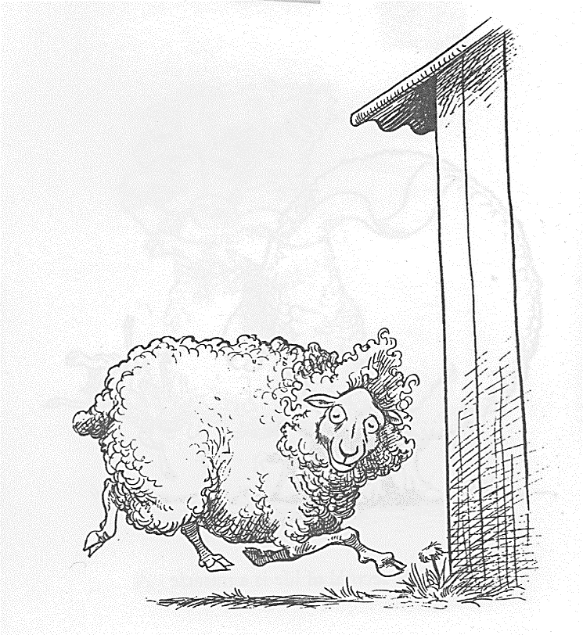
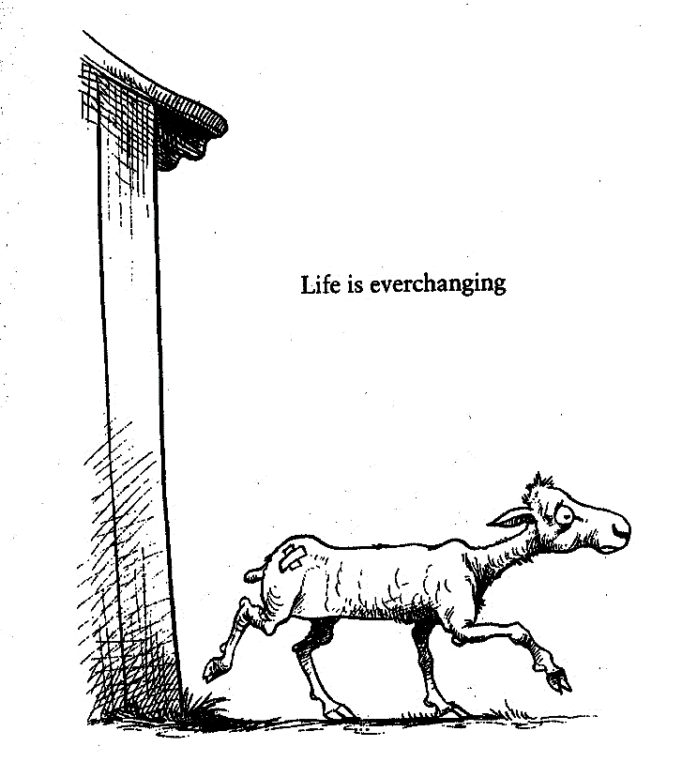
Thank you!
Questions?

